Slide 1
Convolution Neural Network (CNN)
Structure and Function
Architecture
Training
Filters
Layers
Convolution Layer
Pooling Layer
Fully-Connected layer
Applications
Image Recognition
Image Classification
Examples

Slide 2

Structure and Function
Convolution neural networks (CNN) is a class of neural networks where the input is modified through filtering and pooling processes to extract features before applying a fully connected MLP to enable image recognition, object detection, classification, medical image analysis, natural language processing, autonomous vehicles etc.
INPUT (image(s)) => CONV (filters) => Pooling (spatial reduction) => ReLU (activation) => FC => SOFTMAX
Architecture: layers of neurons arranged in 3 dimensions (width, height, depth).
Training: gradient-based optimization to learn extracting features from images.
Filters: detect features (edges, blobs)
Layers: multiple layers (convolution, pooling, fully connected).
Shared weights: share weights and biases for hidden neurons in a layer to detect the same features.
Sparse interactions: to detect meaningful information from images.

Slide 3
Train a CNN
Training a CNN requires several key steps, starting with data preparation, model architecture design, then moving on to training and evaluation. This involves defining a loss function, an optimizer, and careful monitoring the training process.
Data Preparation:
Collect data relevant to the task (images for object detection, audio data for speech recognition etc.)
Label data which are the correct answers that the CNN will learn to predict.
Split the data into training, validation, and test sets.
Augment data (optional) by applying transformations like rotations, flips, or crops for new training examples.
Normalize the pixel values of images or other data to a similar range (e.g., 0 to 1).
2. Model Architecture Design:
Convolution layers with appropriate filters, kernel sizes, and stride to extract features from the input data.
Pooling layers to reduce the spatial dimensions of the feature maps.
Activation functions like ReLU to introduce non-linearity into the model.
Fully connected layers (optional) to make final predictions.
Batch normalization (optional) to stabilize training and improve performance.
Dropout (optional) to prevent overfitting.

Slide 4
Loss function and Optimizer:
Choose a loss function that measures the difference between predicted values and true labels (cross-entropy for classification tasks).
Select an optimizer like SGD or Adam to update the model’s weights and biases based on the loss function.
Training and Evaluation:
Forward pass by feeding the training data through the CNN to make predictions.
Compute the loss based on the predicted values and the true labels.
Backpropagate the gradient of the loss function with respect to the model’s parameters.
Update the model’s weights and biases using the optimizer.
Evaluate by monitoring the training process evaluating the model’s performance on the validation set during training to detect overfitting or underfitting.
Testing and Deployment:
Evaluate the trained CNN on the test set to assess its generalization ability.
Deploy the trained model for making predictions on new, unseen data.
Tips for Faster Training:
Lower the batch size to potentially speed up training.
Use smaller kernel sizes in convolution layers (e.g., 3x3 or 5x5 filters).
Use a GPU for faster training.
Preprocess the data effectively to ensure consistent input.
Add more convolutional layers to capture more complex features.

Slide 5
CNN Filters
In CNN, filters (concatenation of kernels) are used to extract features from input data, like images. They are learned during the training process and are designed to detect specific patterns or features. The kernels/filters are small matrices that slide over the input data, performing a convolution operation. The resulting feature maps are then used as input for subsequent layers in the CNN.
Edge Detection Filters:
Prewitt and Sobel Filters detect edges in images by finding abrupt changes in pixel intensity.
Laplacian Filter detects edges and corners in an image by identifying regions where the second derivative of pixel intensity is non-zero.
Robinson and Kirsch Compass Filter detects edges in different directions by using different filter kernels.
Feature Extraction Filters:
Low-pass Filters emphasize low-frequency components representing smooth areas or edges.
High-pass Filters emphasize high-frequency components representing sharp edges or noise.
Band-pass Filters pass a specific range of frequencies allowing for selective feature extraction.
Notch Filters (Band-stop) block a specific range of frequencies useful for removing unwanted noise or artifacts.
Learnable Filters:
CNN Filters are learned during training, and each filter learns to detect a specific feature.
Features Maps are outputs of CNN layers, each represents a different feature extracted by a corresponding filter.

Slide 6
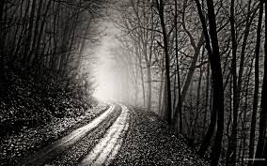
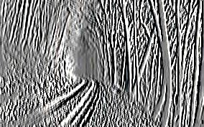
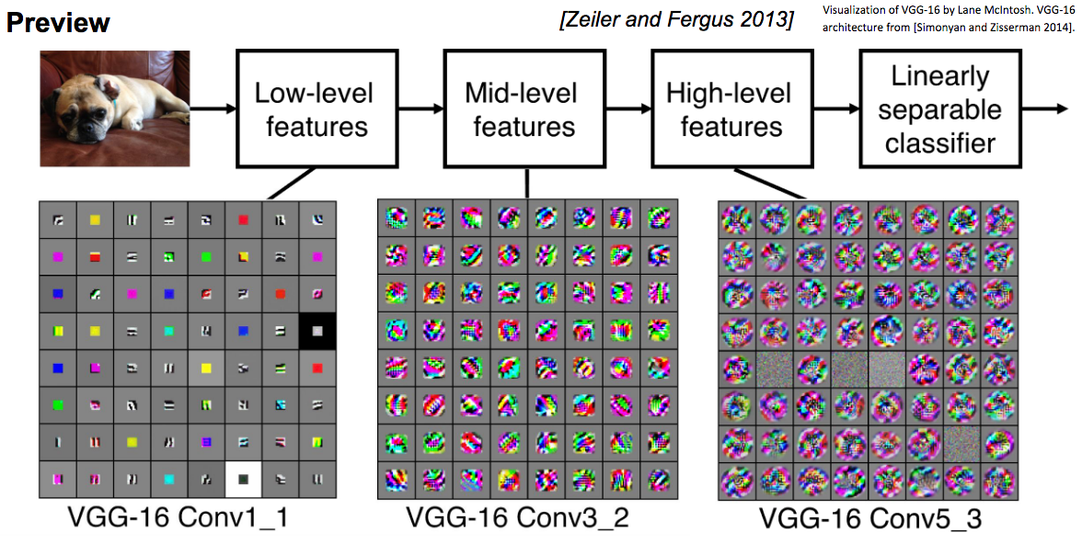
-1 0 1
-1 0 1
-1 0 1
*
=

Slide 7
Convolution layer: elementwise multiplication
Horizontal
10 | 10 | 10 | 0 | 0 | 0
10 | 10 | 10 | 0 | 0 | 0
10 | 10 | 10 | 0 | 0 | 0
0 | 0 | 0 | 10 | 10 | 10
0 | 0 | 0 | 10 | 10 | 10
0 | 0 | 0 | 10 | 10 | 10
1 | 1 | 1
0 | 0 | 0
-1 | -1 | -1
0 | 0 | 0 | 0
30 | 10 | -10 | -30
30 | 10 | -10 | -30
0 | 0 | 0 | 0
*
=
Vertical
1 | 0 | -1
1 | 0 | -1
1 | 0 | -1

Slide 8
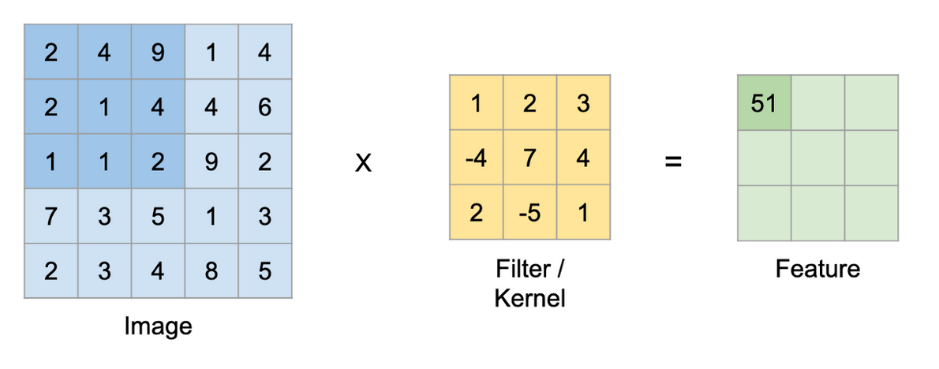
Example: (Complete the feature matrix)
Input (image) has only one channel (grey scale), so one channel per filter!

Slide 9
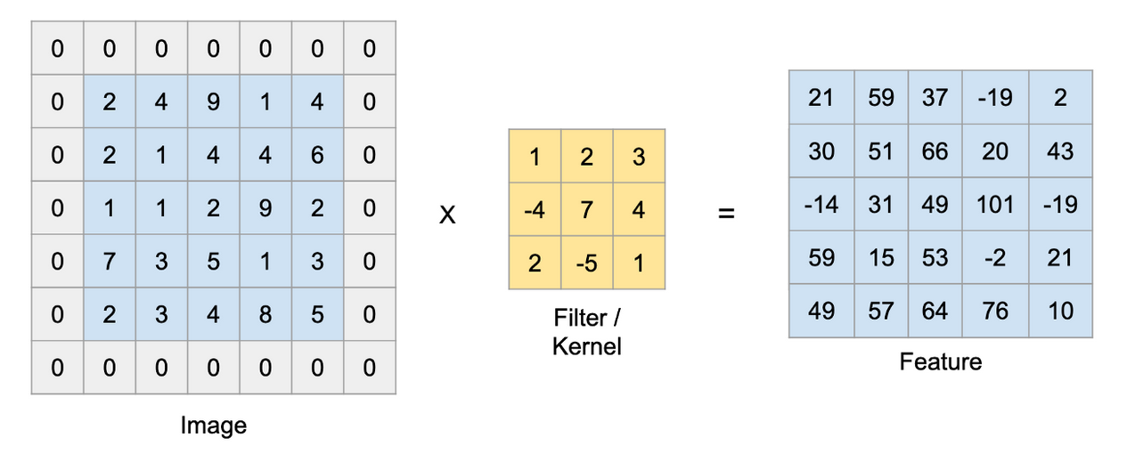
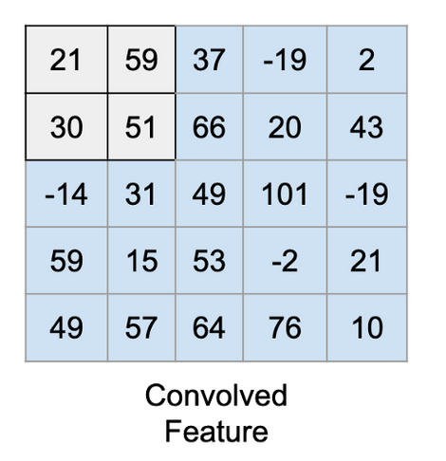
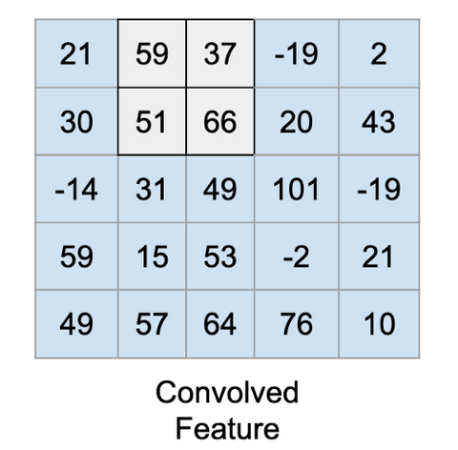
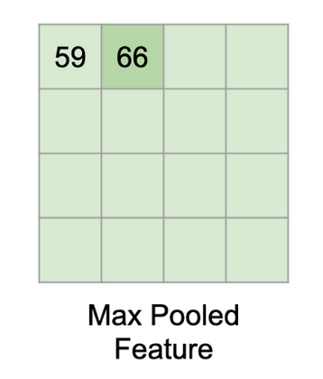
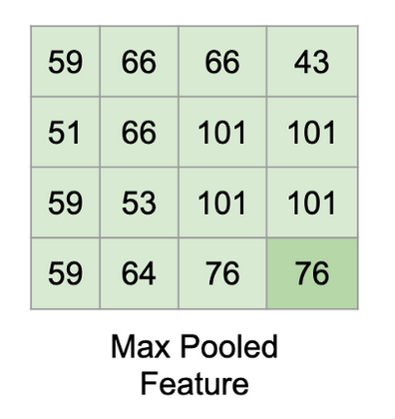
Feature size = ((Image size + 2 * Padding size − Kernel size) / Stride)+1
MaxPool(Relu(x)) = Relu(MaxPool(x))

Slide 10
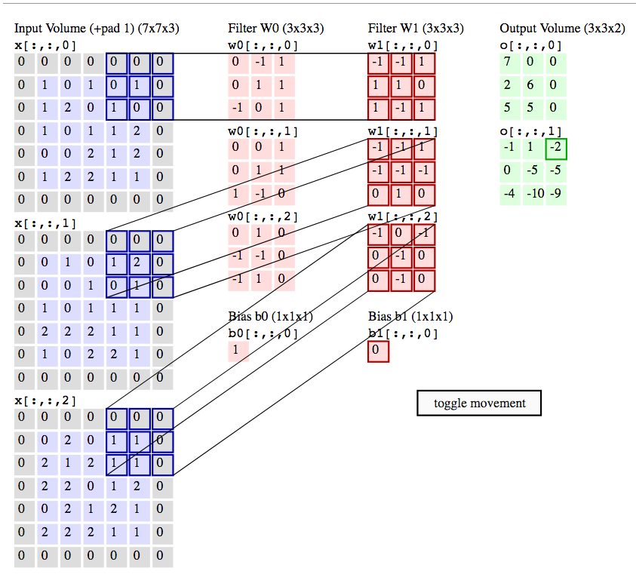
CNN with multiple input channels (RGB)

Slide 11
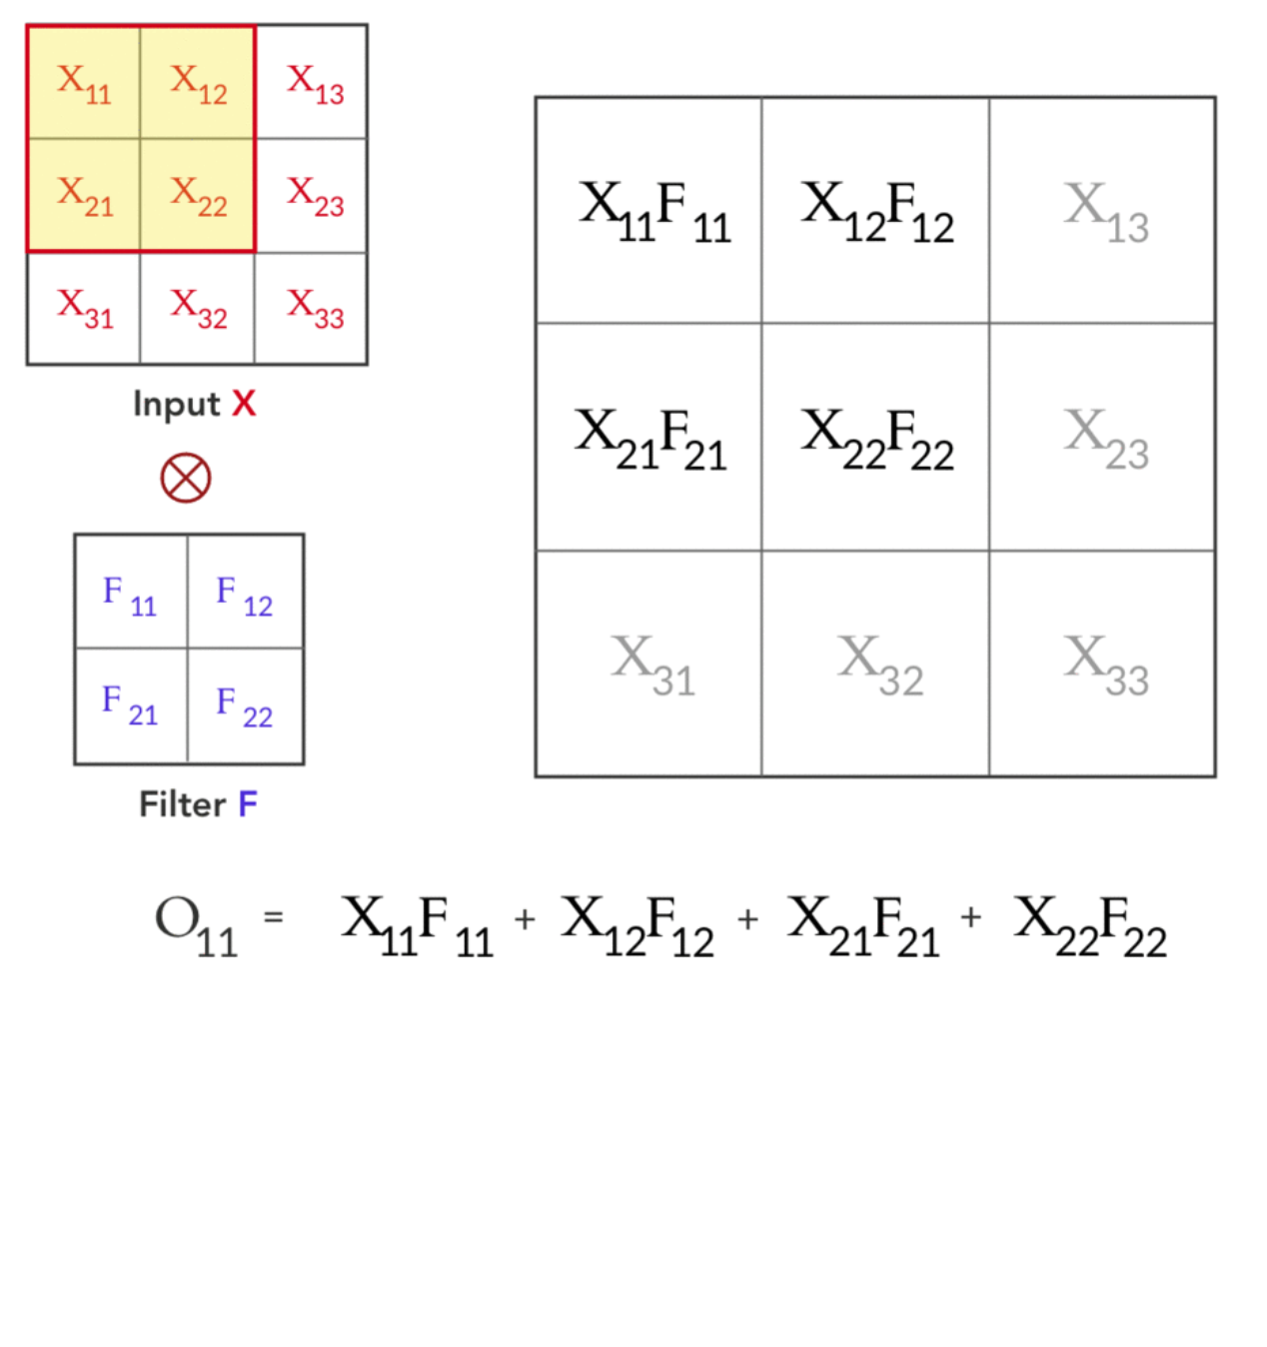
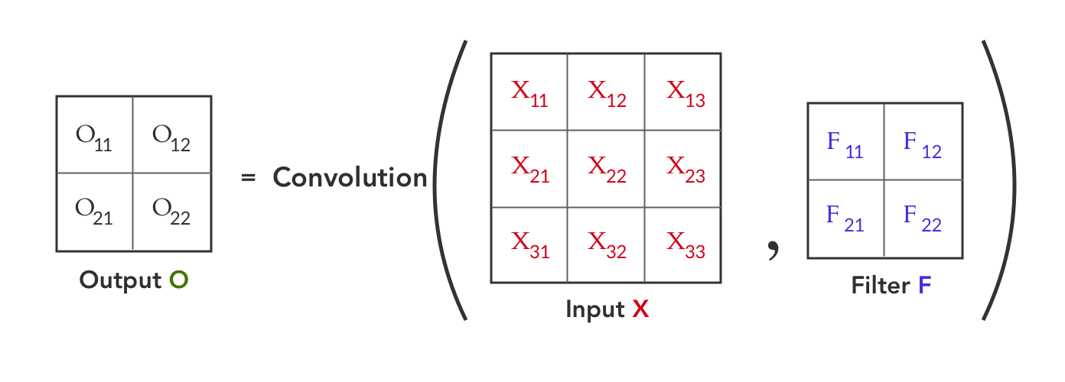
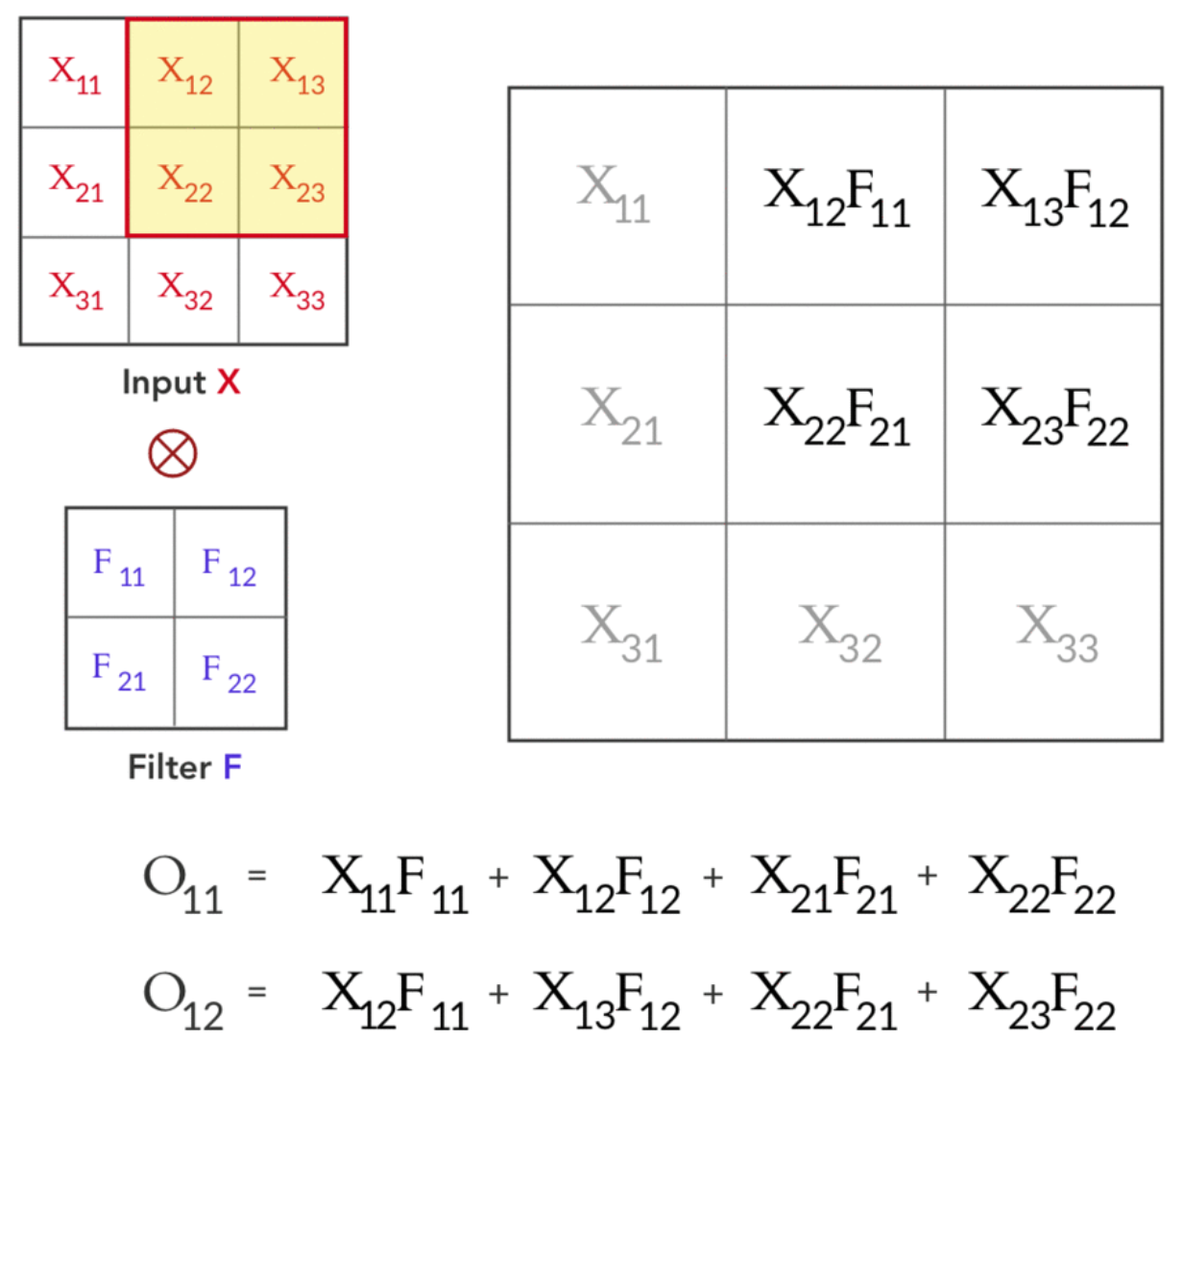
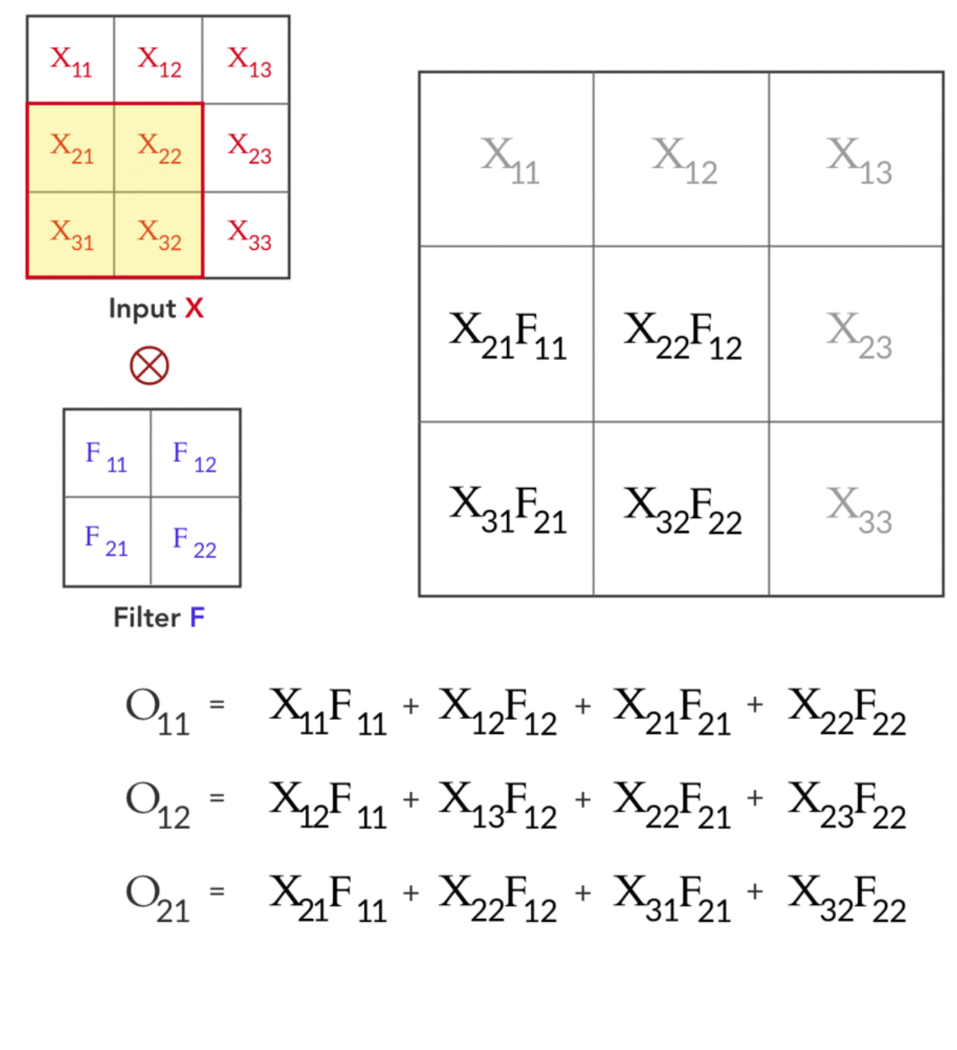
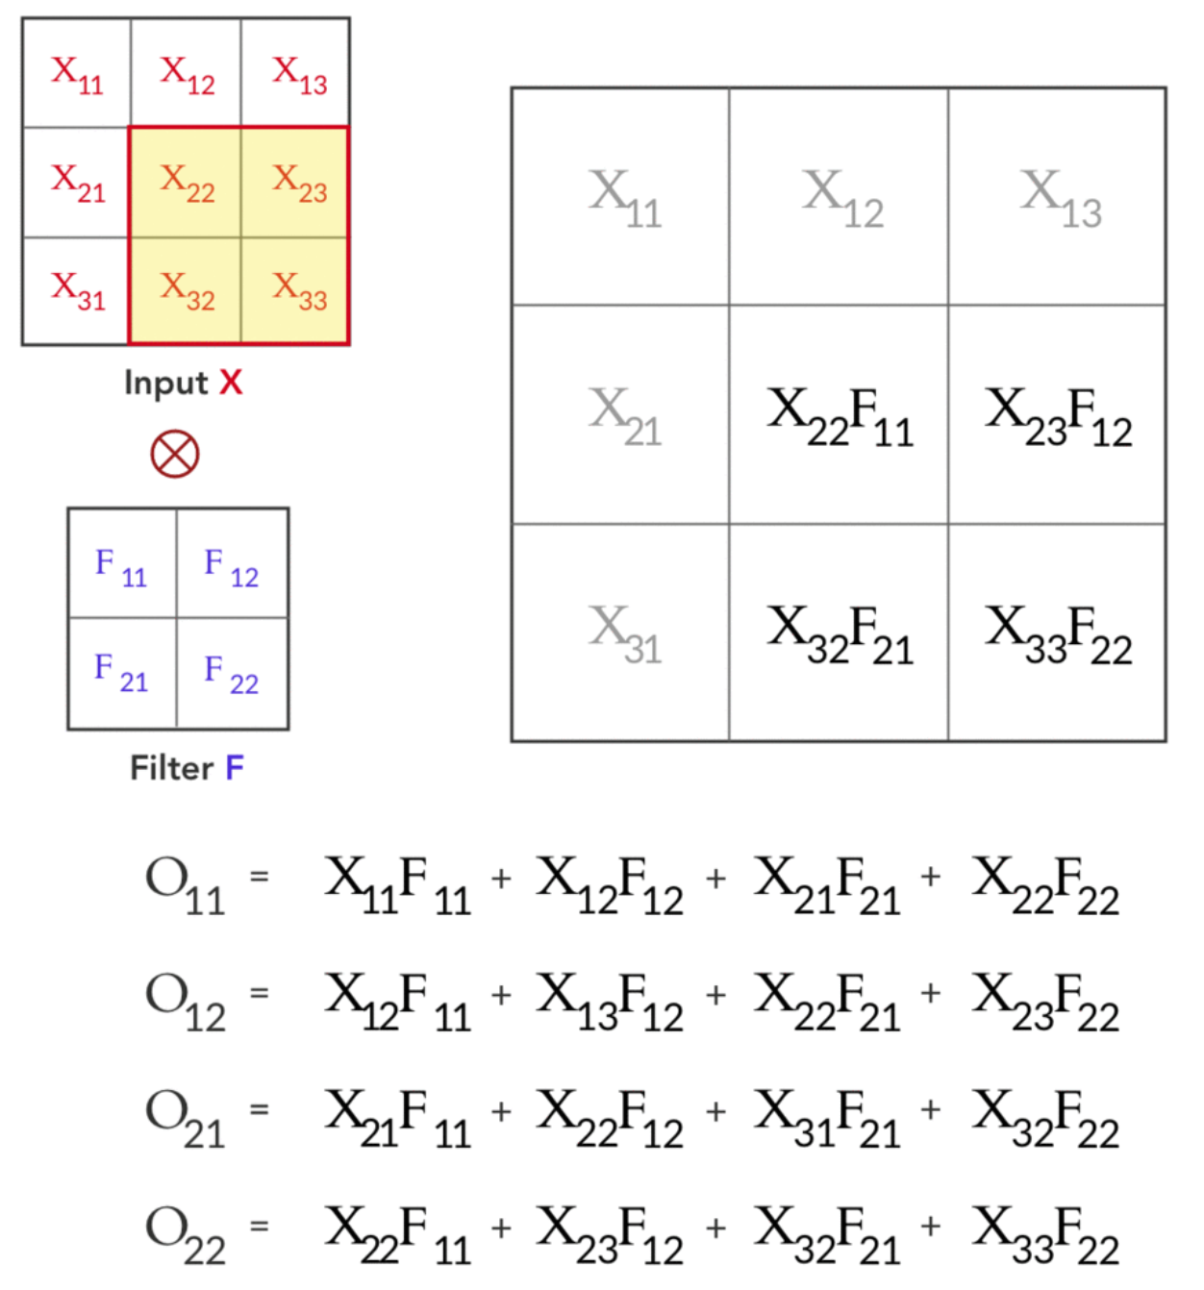
Forward path

Slide 12
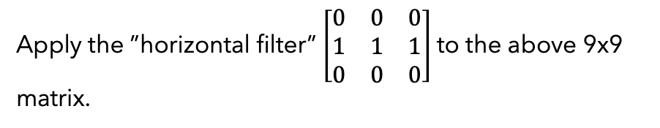
Example of convolution kernel applied matrix
to the 9x9 input image of the PLUS sign.
Apply the 3x3 convolution kernel
To obtain a 7x7 matrix
Apply the ”horizontal filter” $\left[\begin{matrix}0 & 0 & 0 \\ 1 & 1 & 1 \\ 0 & 0 & 0\end{matrix}\right]$to the above 9x9 matrix.

Slide 13
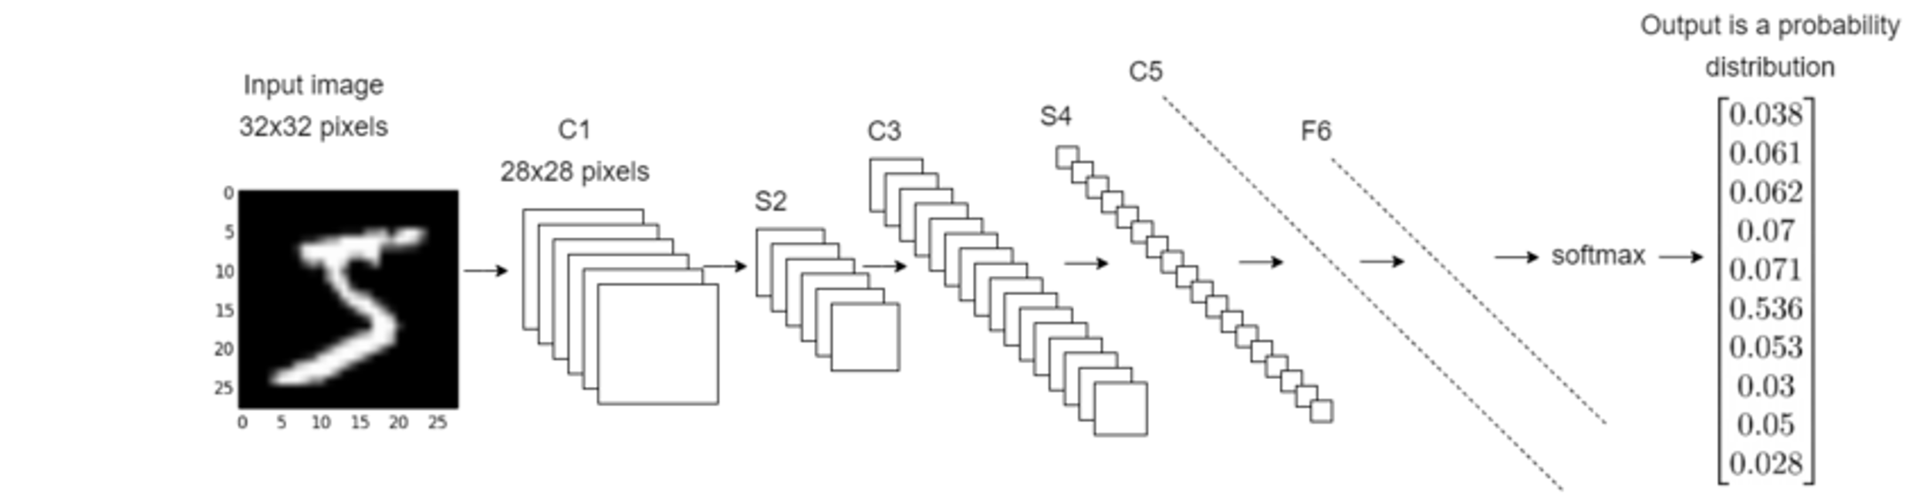
CNN Applications
C1: First convolution layer, consists of conv. Kernels(filters) of size 5x5. outputs 6 images of size 28x28
S2: Subsampling layer (avg pooling layer). Each square of 4 pixels in C1 output is averaged to a simple pixel. S2 scales down the size to 28x28 by 2, producing 6 outputs of size 14x14.
C3: Second convolution layer, consists of 16 convolution kernels, each of size 5x5, to produce 16 images of size 10x10.
S4: Second average pooling layer. Scales down the 16 10x10 images to 16 5x5 images.
C5: Fully connected conv. Layer with 120 output nodes, each is connected to all 400 nodes from S4.
F6: Fully connected layer mapping the 1-D 120 array to a new array of length 10 (Coor. To digits 0-9)

Slide 14
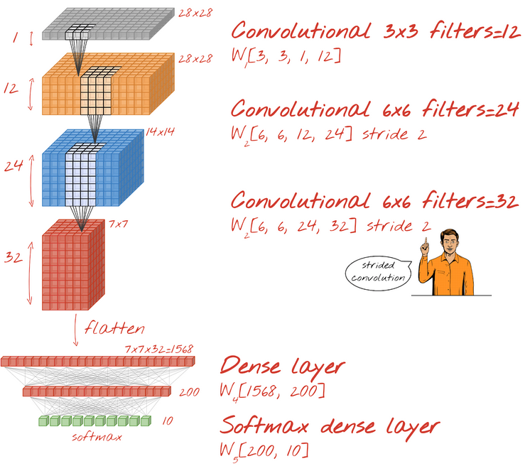
CNN Model with Tensorflow (Mnist 28x28 pixels)
tf.keras.layers.Reshape(input_shape=(28*28,), target_shape=(28, 28, 1))
tf.keras.layers.Conv2D(kernel_size=3, filters=12, padding='same', activation='relu')
tf.keras.layers.Conv2D(kernel_size=6, filters=24, padding='same', activation='relu’,strides=2)
tf.keras.layers.Conv2D(kernel_size=6, filters=32, padding='same', activation='relu’, strides=2)
tf.keras.layers.Flatten()
tf.keras.layers.Dense(200, activation='relu’)
tf.keras.layers.Dense(10, activation=‘softmax’)

Slide 15
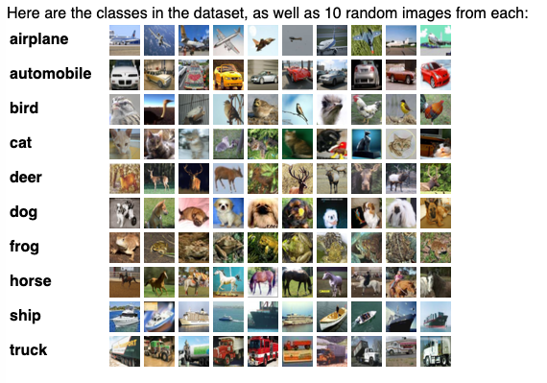
CIFAR-10 Dataset
The CIFAR-10 dataset (Canadian Institute For Advanced Research) is a collection of images that are commonly used to train machine learning and computer vision algorithms. The CIFAR-10 dataset contains 60,000 32x32 color images in 10 different classes. There are 6,000 images of each class. Since the images in CIFAR-10 are low-resolution (32x32), this dataset can allow researchers to quickly try different algorithms to see what works.

Slide 16
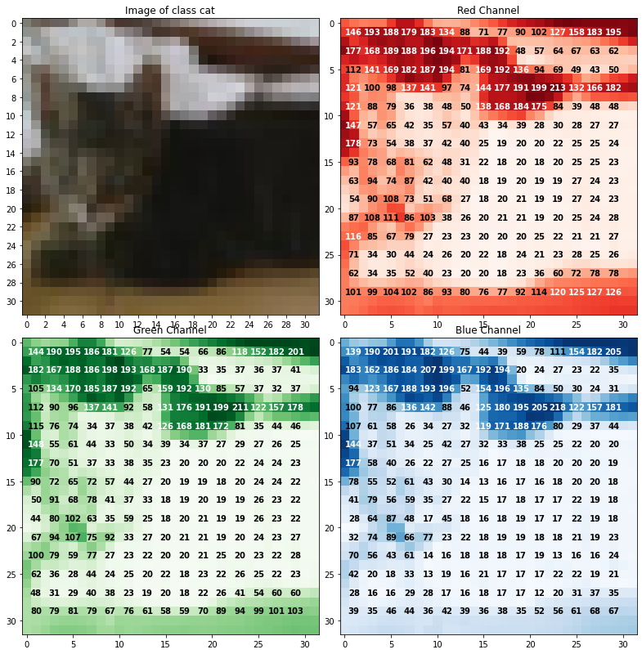
CNN Model with TensorFlow (CIFAR 10 Dataset)
Loading the CIFAR10 Dataset
import tensorflow as tf
cifar10 = tf.keras.datasets.cifar10 #download the images
(x_train, y_train), (x_test, y_test) = cifar10.load_data()
Each Image is a 32x32 image of one of 10 objects
There are 50,000 training images and 10000 testing images
#normalize
x_train, x_test = x_train / 255.0, x_test / 255.0

Slide 17
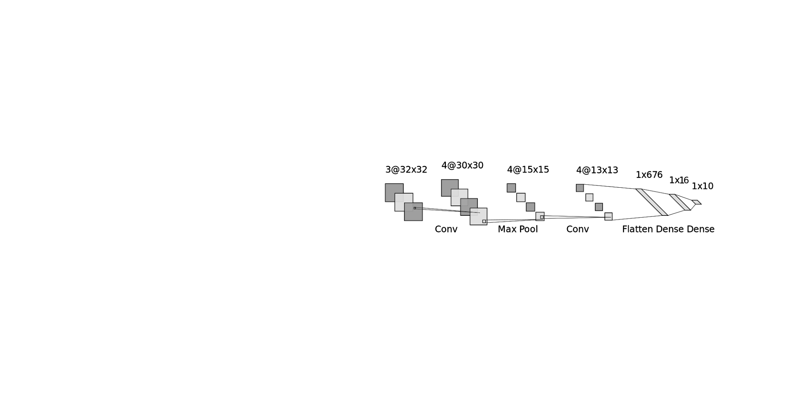
model = tf.keras.models.Sequential([
tf.keras.layers.Conv2D(4, (3, 3), activation='relu', input_shape=(32, 32, 3)),
tf.keras.layers.MaxPooling2D((2, 2)),
tf.keras.layers.Conv2D(4, (3, 3), activation='relu'),
tf.keras.layers.Flatten(),
tf.keras.layers.Dense(16, activation='relu'),
tf.keras.layers.Dense(10, activation='softmax')
]) loss_fn = tf.keras.losses.SparseCategoricalCrossentropy(from_logits=True) model.compile(optimizer='adam',
loss=loss_fn,
metrics=['accuracy'])
model.summary()
model.fit(x_train, y_train, epochs=3,
batch_size = 10)
Batch Size: how many images do we pass through the network for each iteration (10)
Epochs: how many times we pass over the entire dataset (3)
# Iterations per Epoch = number of images / batch size (50,000/10=5,000)

Slide 18
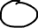
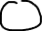
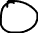
Example
Input
Filter
What are the values of the output at the end of the forward path?
Apply ReLu activation after convolution step
Flatten the values after applying ReLu
Assume stride 1, no padding.
Connect Flattened Input to a fully connected 2-neuron layer, then pass results to a softmax binary
classification of 2 neurons
Assume first layer weights at each link to be 0.1 to 0.8 with bias b2=0.2, second layer weights 0.1 to 0.4 with bias b3=0.3 to a fully connected layer of 2 softmax neurons
Output labels of 2 classes are 1.0 and 0.0

